Slide 1


VISVESVARAYA TECHNOLOGICAL UNIVERSITY
Belagavi - 590 018
BAI586 – Mini Project
Gesture & Voice Game Control Using Python
Presented By:
Suchithra A U 1AY23AI121
Dasarapalli Manjunatha 1AY24AI401
Sahil P Malge 1AY24AI407
Sangamesh Nandi 1AY24AI408
Under the Guidance of Dr. Kavitha Nair R Assistant Professor
DEPARTMENT OF ARTIFICIAL INTELLIGENCE AND MACHINE LEARNING ACHARYA INSTITUTE OF TECHNOLOGY

Slide 2
Content
Abstract
Introduction
Literature Survey
System Architecture
Methodology
Testing
Results
Demo
Demonstration Of Prototype
Future Works
Conclusion
DEPARTMENT OF ARTIFICIAL INTELLIGENCE AND MACHINE LEARNING ACHARYA INSTITUTE OF TECHNOLOGY

Slide 3
Abstract
Controlling PC games requires hands-on peripherals, limiting accessibility and immersion
This project develops a dual-mode controller using gestures and voice for hands-free game interaction
To build a system that translates webcam gestures and microphone commands into keyboard actions
Utilizes MediaPipe for hand tracking and vosk for speech recognition to trigger PyAutoGUI keyboard events
A working prototype system that has four different control modes for different types of games.
DEPARTMENT OF ARTIFICIAL INTELLIGENCE AND MACHINE LEARNING ACHARYA INSTITUTE OF TECHNOLOGY

Slide 4
Introduction
Gesture recognition and voice recognition are both important parts of Human–Computer Interaction (HCI).
Python with OpenCV and MediaPipe helps detect hand gestures and control game objects.
Python with SpeechRecognition and PyAudio helps detect commands and control game actions.
The goal is to create a touchless, interactive gaming experience.
DEPARTMENT OF ARTIFICIAL INTELLIGENCE AND MACHINE LEARNING ACHARYA INSTITUTE OF TECHNOLOGY

Slide 5
Literature Survey
Sl No. | Citation | Methodology | Limitation/Research gap
1. | [1] A B et al, "Investigating the Use of Vosk for Speech to Text in Interactive Gaming Applications," Preprints.org, 2025 | Evaluated the Vosk offline speech toolkit for real-time transcription in games Measured Word Error Rate (WER) and command latency | Did not address the need for a stateful "hold" and "release" mechanism for commands like "gas" or "accelerate"
2. | [2] M E et al, "Continuous hand gesture recognition: Benchmarks and methods," Comput Vis Image Underst, 2025 | Reviews benchmarks for "continuous“ gesture recognition (tracking movement over time) vs "static" (single pose) recognition | Existing systems struggle to differentiate between a single gesture command and an intended continuous "hold" command
DEPARTMENT OF ARTIFICIAL INTELLIGENCE AND MACHINE LEARNING ACHARYA INSTITUTE OF TECHNOLOGY

Slide 6
Literature Survey
Sl No. | Citation | Methodology | Limitation/Research gap
3. | [3] S S et al, "Gesture Based System Control Using Opencv and Mediapipe," Int J of Research and Paced Rev (IJRPR), vol 6, no 6, 2024 | Used MediaPipe for 21- landmark hand tracking and OpenCV to process frames | System focused on single, one-shot actions (like press)
4. | [4] C Bowyer, "How can voice-controlled technology be used in interactive games for individuals with motor skill impairments?" Research Report, 2022 | Developed a prototype platformer game controlled by simple voice commands like "up," "down," "left," and "right" | The system maps commands to discrete, one-shot actions (like a single key press)
DEPARTMENT OF ARTIFICIAL INTELLIGENCE AND MACHINE LEARNING ACHARYA INSTITUTE OF TECHNOLOGY

Slide 7
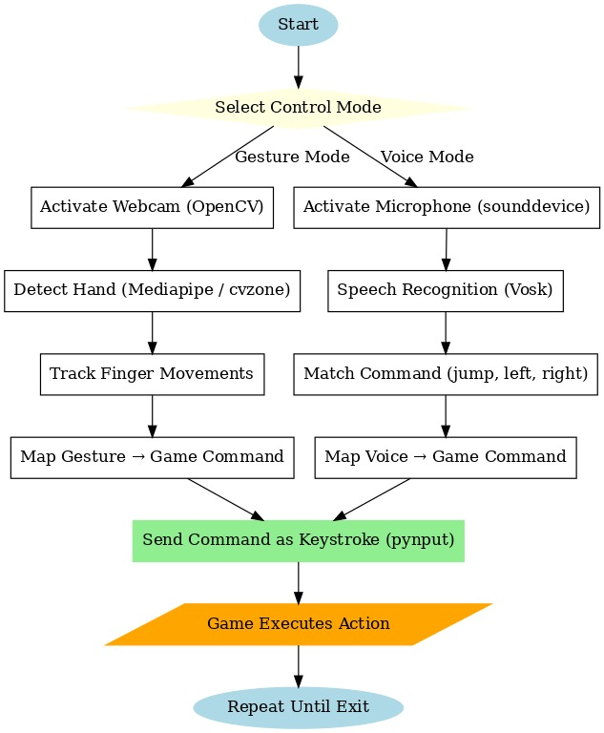
System Architecture
Fig 1: System architecture
DEPARTMENT OF ARTIFICIAL INTELLIGENCE AND MACHINE LEARNING ACHARYA INSTITUTE OF TECHNOLOGY

Slide 8
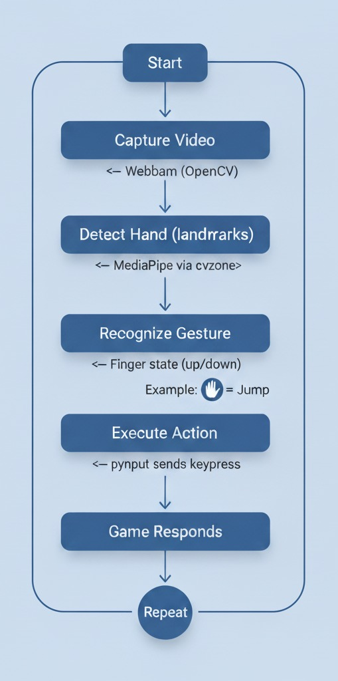
Flow Diagram
Fig 2: Flow diagram for Gesture Control
DEPARTMENT OF ARTIFICIAL INTELLIGENCE AND MACHINE LEARNING ACHARYA INSTITUTE OF TECHNOLOGY

Slide 9
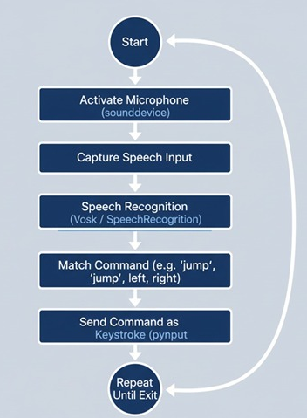
Flow Diagram
Fig 3: Flow diagram for Voice Control
DEPARTMENT OF ARTIFICIAL INTELLIGENCE AND MACHINE LEARNING ACHARYA INSTITUTE OF TECHNOLOGY

Slide 10
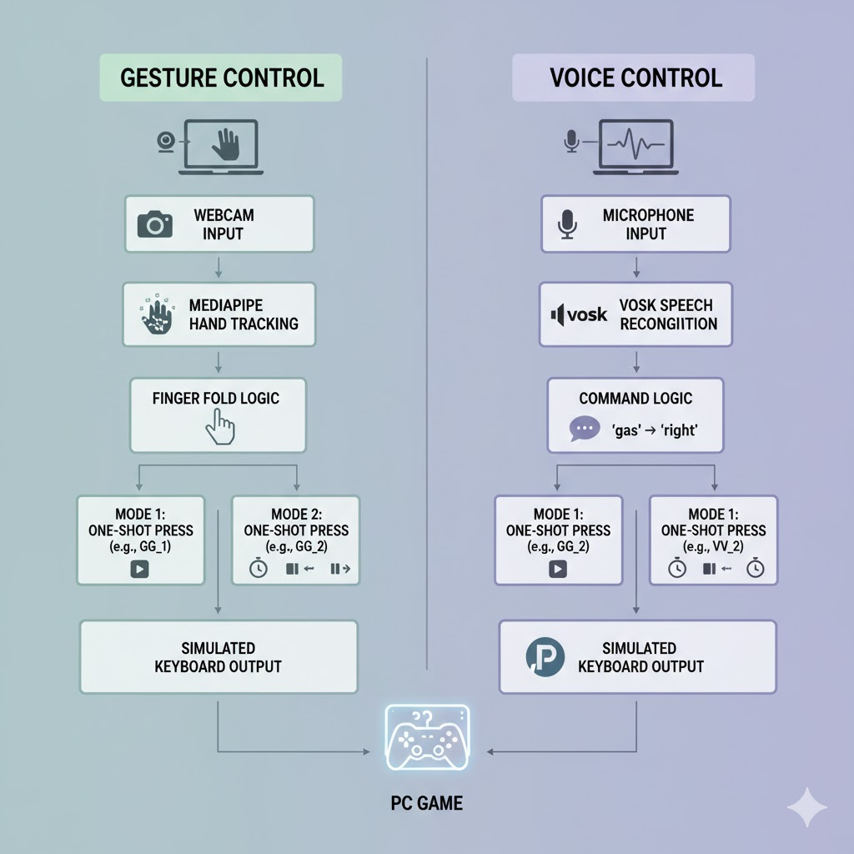
Methodology
Fig 4: Game control system methodology
DEPARTMENT OF ARTIFICIAL INTELLIGENCE AND MACHINE LEARNING ACHARYA INSTITUTE OF TECHNOLOGY

Slide 11
Methodology: Gesture Control
Tools: OpenCV, MediaPipe, PyAutoGUI
Algorithm (GG_2): Capture frame
Process with mp.solutions.hands
Check Y-coord of TIP (e.g., 8) vs DIP (e.g., 6) for 5 fingers
detect_action maps folded fingers to key (e.g., Middle+Ring = "stop")
press_key calls pyautogui.keyDown and sets auto-release timer
DEPARTMENT OF ARTIFICIAL INTELLIGENCE AND MACHINE LEARNING ACHARYA INSTITUTE OF TECHNOLOGY

Slide 12
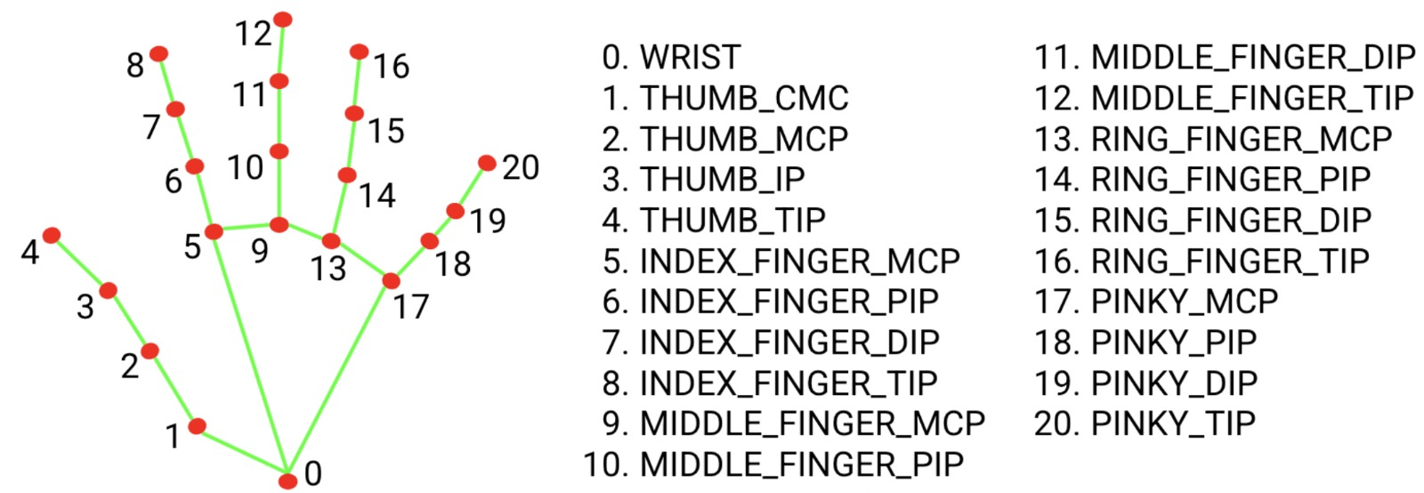
Methodology: Gesture Control
Fig 5: MediaPipe 21 landmarks
DEPARTMENT OF ARTIFICIAL INTELLIGENCE AND MACHINE LEARNING ACHARYA INSTITUTE OF TECHNOLOGY

Slide 13
Methodology: Voice Control
Tools: Vosk, Sound device, PyAutoGUI
Algorithm (VV_2): sounddevice.RawInputStream feeds audio into a queue
vosk.Kaldi Recognizer processes data from the queue
Partial results are checked for immediate response
Recognized tokens are mapped to HOLD _KEYS(Key Down) or PRESS_KEY(Press)
"stop" command releases all keys in the held dictionary
Auto-release timer (5.0s) prevents stuck keys
DEPARTMENT OF ARTIFICIAL INTELLIGENCE AND MACHINE LEARNING ACHARYA INSTITUTE OF TECHNOLOGY

Slide 14
System Testing
Test Case ID | Test Type | Input Description | Expected Output | Actual Result | Status
TC-01 | Unit Testing | Gesture: User folds Thumb (while other fingers are open) | System detects "up" command and triggers pyautogui.keyDown('up') | Key 'up' is held down (accelerate) | Pass
TC-02 | Unit Testing | Voice: User says "Jump" into microphone | Vosk recognizes "jump" or "up" and triggers pyautogui.press('up') | Single key press 'up' registered | Pass
TC-03 | Functional | Gesture: User folds Middle + Ring fingers simultaneously | System detects "stop" command | All held keys released | Pass
DEPARTMENT OF ARTIFICIAL INTELLIGENCE AND MACHINE LEARNING ACHARYA INSTITUTE OF TECHNOLOGY

Slide 15
System Testing
Test Case ID | Test Type | Input Description | Expected Output | Actual Result | Status
TC-04 | Functional | Voice: User says "Gas" (synonym for right) | System maps "gas" to "right" and triggers keyDown | Key 'right' is held down | Pass
TC-05 | Integration | Combined: Running main.py and selecting Option 2 (Racing Gesture) | Opens GG_2.py and activates webcam window | Webcam stream opens and overlays landmarks | Pass
TC-06 | System | Gameplay: Playing "Hill Climb" using Voice Mode 2 | Speaking "Gas", "Brake", "Stop" while game is active | Car accelerates, brakes, and stops correctly | Pass
DEPARTMENT OF ARTIFICIAL INTELLIGENCE AND MACHINE LEARNING ACHARYA INSTITUTE OF TECHNOLOGY

Slide 16
Results & Discussion
Gesture Action | Attempts | Successful Detection | Accuracy (%)
Right (Index) | 50 | 48 | 96%
Up (Thumb) | 50 | 47 | 94%
Ring | 50 | 49 | 98%
Overall | 150 | 144 | 96.0%
Gesture Control Accuracy (Sample Size: 50)
Voice Command | Attempts | Successful Detection | Accuracy (%)
"Gas" / "Right" | 50 | 45 | 90%
"Jump" / "Up" | 50 | 46 | 92%
"Stop" | 50 | 50 | 100%
Overall | 150 | 141 | 94.0%
Voice Control Accuracy (Sample Size: 50)
DEPARTMENT OF ARTIFICIAL INTELLIGENCE AND MACHINE LEARNING ACHARYA INSTITUTE OF TECHNOLOGY

Slide 17
Results & Discussion
System Latency (Response Time)
Module | Processing Type | Average Latency (ms)
Gesture (MediaPipe) | Frame Capture + Landmark Detection | ~45 ms
Voice (Vosk) | Audio Buffer + Text Decoding | ~250 ms
Action Trigger | Python Logic to PyAutoGUI | ~5 ms
Total System Delay | Input to Game Response | ~50ms (Gesture) / ~255ms (Voice)
DEPARTMENT OF ARTIFICIAL INTELLIGENCE AND MACHINE LEARNING
ACHARYA INSTITUTE OF TECHNOLOGY

Slide 18
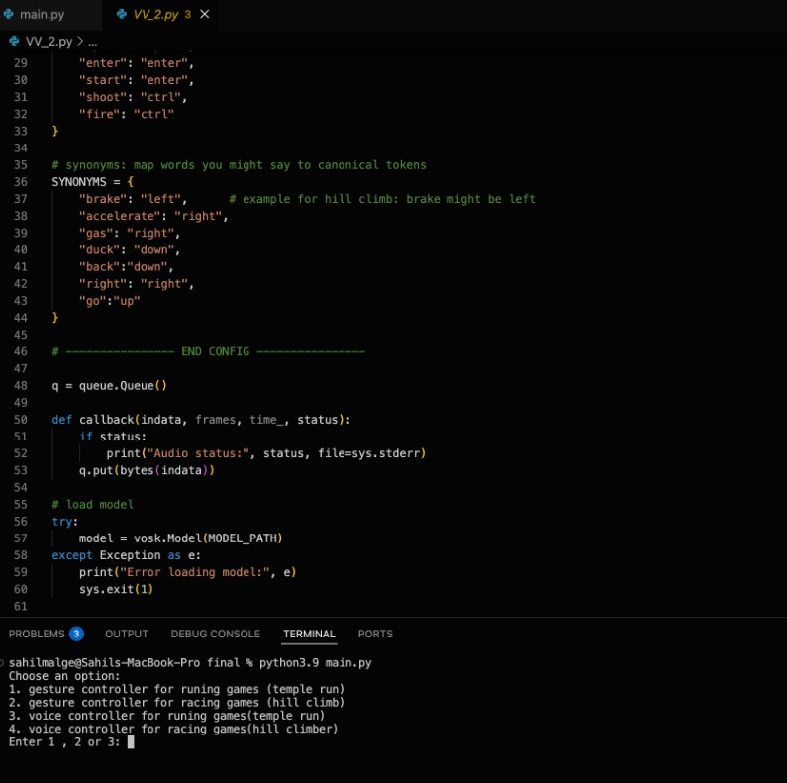
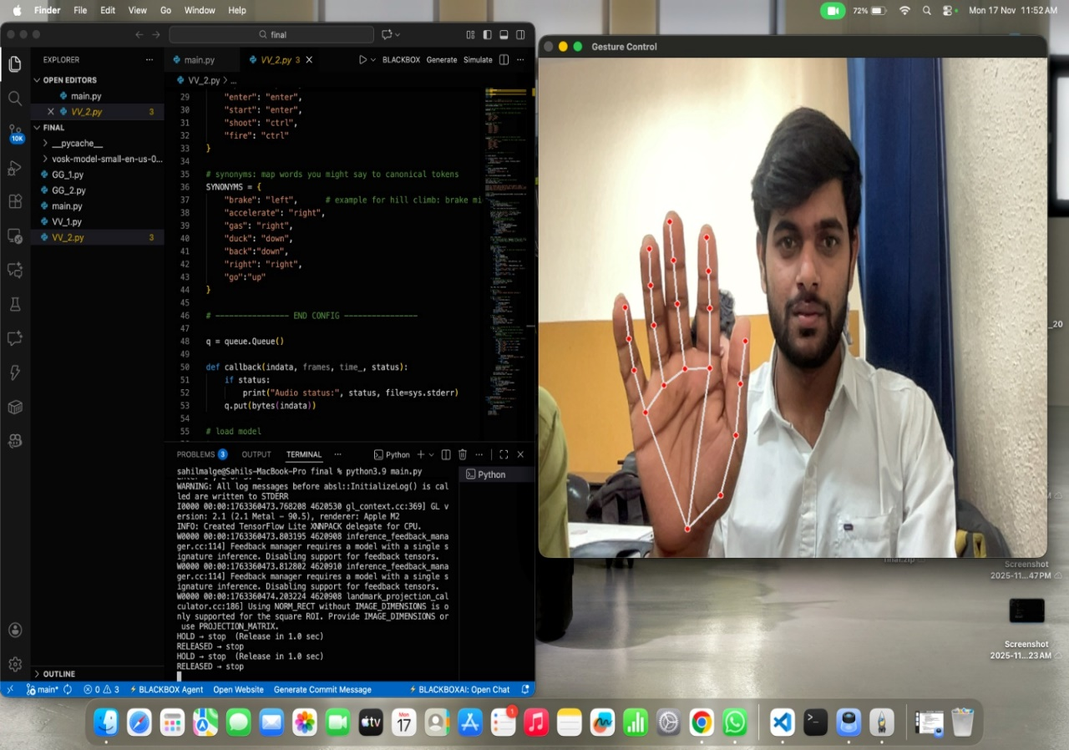
Demonstration of Prototype
DEPARTMENT OF ARTIFICIAL INTELLIGENCE AND MACHINE LEARNING
ACHARYA INSTITUTE OF TECHNOLOGY

Slide 19
Future Works
Add more gesture actions
Improve robustness under different lighting
Integrate deep learning models
Add multi-language support
Improve noise cancellation
We plan to create a website for our project in the future(graphical user interface)
DEPARTMENT OF ARTIFICIAL INTELLIGENCE AND MACHINE LEARNING ACHARYA INSTITUTE OF TECHNOLOGY

Slide 20
Conclusions
The system uses gesture and voice for powerful touchless interaction.
This project successfully works in real-time using gesture-based and voice –based for gaming with Python.
The interaction become fast and easy for users.
It shows strong potential for gaming, automation, and accessibility.
Overall, the project is simple, effective, and user-friendly.
DEPARTMENT OF ARTIFICIAL INTELLIGENCE AND MACHINE LEARNING ACHARYA INSTITUTE OF TECHNOLOGY

Slide 21
Reference
[1] M E et al, "Continuous hand gesture recognition: Benchmarks and methods," Compute Vis Image Underset, 2025
[2] A B et al, "Investigating the Use of Vosk for Speech to Text in Interactive Gaming Applications," Preprints.org, 2025
[3] S. S. et al., "Gesture Based System Control Using Opencv and Mediapipe," IJRPR, vol. 6, 2024.
[4] MediaPipe Hands, Google Developers. Available: developers.google.com/mediapipe
[5] Vosk Offline Speech Recognition API. Available: alphacephei.com/vosk
[6] PyAutoGUI Documentation. Available: pyautogui.readthedocs.io
DEPARTMENT OF ARTIFICIAL INTELLIGENCE AND MACHINE LEARNING ACHARYA INSTITUTE OF TECHNOLOGY

Slide 22

Any Questions?
DEPARTMENT OF ARTIFICIAL INTELLIGENCE AND MACHINE LEARNING ACHARYA INSTITUTE OF TECHNOLOGY

Slide 23

DEPARTMENT OF ARTIFICIAL INTELLIGENCE AND MACHINE LEARNING ACHARYA INSTITUTE OF TECHNOLOGY

